Slide 1
APPLIED ANATOMY: POSTURE AND GAIT
By Jeff C. Conforti, DPT

Slide 2
LEARNING OBJECTIVES
To understand the basic elements of posture and gait
To learn the phases of gait
To learn the key muscles and their function during each phase of gait
Recognize the clinical implications of injury, loss or disease on mobility

Slide 3
FORM AND FUNCTION
Posture and gait are the outcome of our battle with gravity. They represent our ability to function in our environment
Posture and gait are the processes for our stability and mobility
Efficient and safe = normal gait
Inefficient and unsafe = falls, immobility

Slide 4
LE FORM AND FUNCTION
The bones, muscles and joints of the LE’s are uniquely adapted for stable mobility by:
1. can bear weight
2. maintain balance-static, dynamic
3. provide a means of stable mobility =walking, running, climbing stairs, etc.

Slide 5
The LE’s and pelvis are adapted for stable weight bearing and transfer of weight, energy and forces.
Large bones with increased but congruent joint surfaces
Strong, thick ligaments
Large, strong muscles with reserve capacity
1 & 2 lock the joints with minimal energy use (muscle contraction)

Slide 6
CONCEPTS OF GAIT: DEFINITIONS
Center of gravity (CG)-Point where mass is concentrated, point where forces of gravity act
Positioned within base of support (BOS)
1. Halfway between iliac crests and anterior to S2
2. Posterior to the hip joint (hip extension)
3. Anterior to the knee joint (knee extension)
4. Anterior to the ankle joint (dorsiflexed)
5. Mid foot (supinated, arches

Slide 7
Balance is safely and efficiently main-taining your CG within your BOS against gravity
Posture-static, dynamic (instantaneous)
Movement is changing postures
Gait is movement with purpose that requires changing the position of the CG
Open kinetic chain (OKC)-foot moves
Closed kinetic chain (CKC)-foot on ground
Each is involved with gait

Slide 8
THE GAIT CYCLE
Definition: The rhythmic, stable alternating movements of the 2 lower extremities resulting in forward movement of the body. Walking!
The activity of the joints, muscles and limb movement that occurs between the heel strike of one limb and the subsequent heel strike of the same limb (2 steps)
Two phases for that limb:
1. STANCE (CKC) OR SUPPORT PHASE
2. SWING (OKC) PHASE

Slide 9
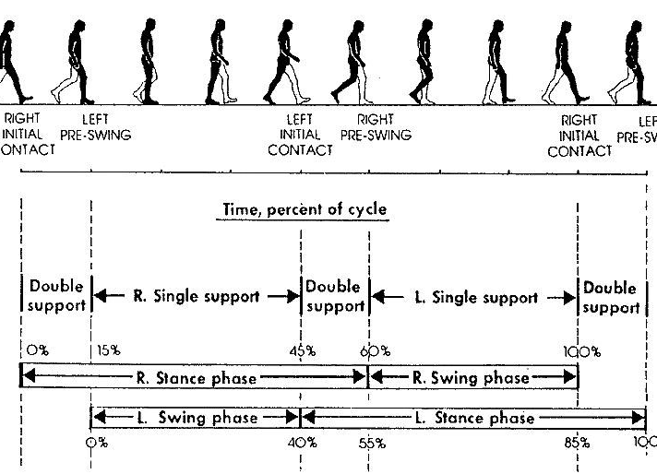
GAIT CYCLE CONT

Slide 10
PHASES OF GAIT CYCLE
STANCE PHASE = LIMB LOADING
  Heel strike
  Mid stance-foot flat, weight over limb
  Toe off/push off – first ray
  60% OF GAIT CYCLE
  SINGLE LEG SUPPORT (SLS) – 30-40%, VS
  DOUBLE LEG SUPPORT (DLS) – 20-30%

Slide 11
PHASES OF GAIT CONT
SWING PHASE = LIMB ADVANCEMENT
  ACCELERATION OF THE LIMB
    Concentric muscle contractions
  DECELERATION OF THE LIMB
    Eccentric muscle contractions
  Controlled by coordinated contraction of muscles

Slide 12
GAIT MECHANICS: TERMINOLOGY
Step length
Step duration
Cadence (90-120 steps/min, normal)
Stride length
Symmetry is key

Slide 13
MUSCLE ACTIVITY DURING GAIT
1. PHASE: Acceleration to Heel strike
Hip-flexed; all gluteal muscles
Knee-flexed; Quads, hamstrings
Ankle-neutral; Anterior crural muscles
PHASE: Heel strike to midstance
Hip-neutral; Glute med. and minimus
Knee-extended; quads
ankle-dorsiflexed; Gastrocs, soleus
Tarsal-inverted/supinated; TA, TP

Slide 14
MUSCLE ACTIVITY DURING GAIT
PHASE: Midstance to toe off
Hip-extended; Glutes, hip stabilizers
Knee-flexed; gastrocs, hamstrings
Ankle-plantarflexed; gastrocs, soleus
PHASE: Toe off to acceleration
Hip-flexed; iliopsoas, adductors
Knee-flexed; gastrocs
Ankle-Neutral; anterior crural muscles

Slide 15
KEY MUSCLE GROUPS
Primary stabilizers: Glutes, quads
-very important in SLS
Primary movers: Glutes, gastrocs and hip flexors
-Very important in limb advancement

Slide 16
Movement represents the coordination of the nervous, muscular and skeletal systems, dependent on intact, functioning systems.
Compromise o f the nervous system, poor muscle strength, control or endurance, or joints that are restricted, poorly aligned or damaged (arthritis, injury, etc) lead to failed function and decreased efficiency of gait and posture.

Slide 17
ABNORMAL GAIT MECHANICS
Trendelenburg gait-loss of glute medius
Foot drop- loss of dorsiflexors

Slide 18
